Slide 1
Elements of the State
Dr. M Jashim Uddin
NSU

Slide 2
Elements of the State
Population
Territory
Government
Sovereignty

Slide 3
Population
State is a human institution.
How many people are needed to form a state? Can a state have too small or too large a population?
According to Plato, an ideal city-state should have 5040 citizens to achieve the highest good. The number excluded women, children and slaves. Including them the number can be 50,000.
However, Aristotle claimed:
- the population should not be so small as not to become even self- sufficient; nor should it be too large as to become unmanageable.
it should be large enough to ensure its military and economic independence; a very populous state cannot be well governed, so population growth must be checked.

Slide 4
Population
Questions raised; in any particular state, is the population increasing, decreasing or remaining stationary?
What roles are played by food supply, technology, urbanization, religion, education, and war? Should public policy be directed toward stimulating or ignoring the rate of population change?
While some modern states such as the US, Canada are still underpopulated, some others like India and Bangladesh are confronted by population boom; e.g., unbridled population increase that has already brought down the per capita land to 24 decimals or less and cultivable land to some 11 decimals, Rethinking the Population Boom, The Daily Star, 2016)
Should the states confronting population boom encourage birth control, try to increase their food production or go to war to gain land and resources from richer neighboring states?

Slide 5
Population
A balance is desired between the size of the population and the size of the state and resources. A state with a very small population may find it difficult to maintain its independence against states with greater manpower.
What is the role of technology and diplomacy in this situation?
The ideal of national self-determination poses the practical question of whether a state that is small in population and territory can make good its bid for independence against a political colossus like the former Soviet Union or China.

Slide 6
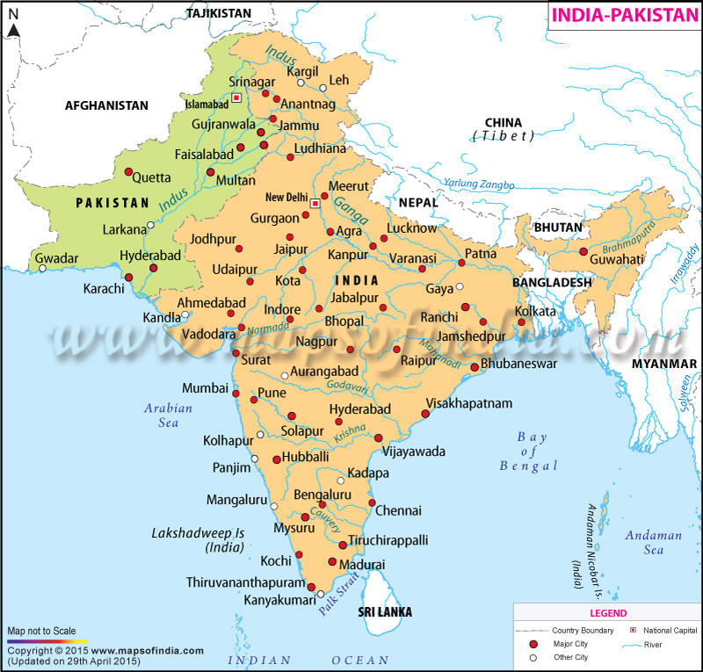
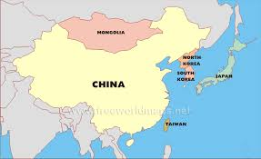
Maps

Slide 7
Population
Characteristic of the population: What kind of people constitute a particular state? Are they literate, well educated, and culturally an vocationally advanced? Are they skilled in modern technology?
Also, are they homogeneous people, made up of one rather than many nationalities? Do they speak a single language? Do they have a common religion and subscribe to the same body of cultural traditions?
Homogeneity is an important factor in state survival.

Slide 8
Population
A state, on the other hand, made up of peoples of diverse race, nationalities, religions, languages, and customs may be subjected to greater internal and external instability.
The basic ingredients of nationalism are common blood, language, religion, historical tradition, and above all common customs and habits
Nationalism
Since the ancient periods people have been aware of their racial or cultural differences, and each people tended to regard itself superior. E.g., The Greeks termed the Non-Greek as “barbarian”; the Jews considered themselves a chosen people

Slide 9
Population Nationalism
But such ethno-centric feelings were not the same as the modern spirit of nationalism, which has made its appearance concurrently with the rise of national state as a new form of political organization, e.g., India.
Another examples are that the people of Spain and England gradually came to regard themselves as Spaniards and Englishmen, rather than Andalusians and Yorkshire-men or other provincial inhabitants as the above countries were transformed from clusters of feudal principalities into national monarchies.

Slide 10
Population Nationalism
What are the factors of the new sense of nationalism?
The invention of the printing press, the development of native languages, wars to secure or maintain the nation’s independence, the building up of a common history and tradition— all these and many other forces combined to produce this modern attitude or spirit called “nationalism.”

Slide 11
Territory
How much territory is necessary for the maintenance of the state?
Existence of different size of independent states ranging from Russia to Mal Dives. According to international law, independent states are equal in rights and status, regardless of inequalities in area and population.
Nevertheless, a tiny country find itself in a risky position, and must seek protection from one or more of the great powers.

Slide 12
Territory
Resources, Technologies and Climate:
Little England became a Great power because of its industrial development, which was possible because of rich natural resources to which technology could be applied. But exceptions are there, e.g., Japan.
People living in the temperate areas are likely to be healthier than those living in the tropics.
Rodee argued, it is natural that people living under favorable climatic conditions (Greeks, Romans, English, French etc) have left a deep imprint on world history. What is your view?

Slide 13
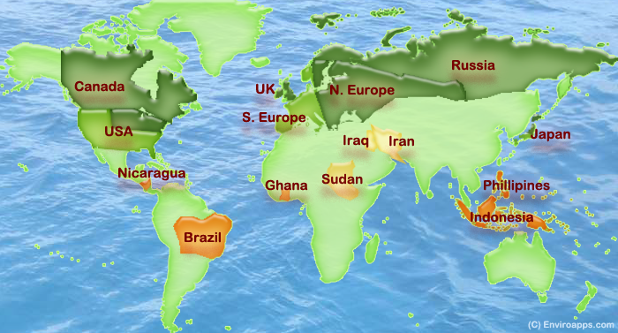
Temperate areas (Dark green)

Slide 14
Territory
Geography
location is also an important factor in a state’s survival and growth; whether a state occupies an island, a peninsula, or an entire continent or whether it has access to sea or is land- locked. Whether it is protected by natural barriers such as oceans, mountains or deserts; or it has powerful and aggressive neighbor states.
Island powers like Great Britain and Japan developed strong navies, whereas continental powers like Russia and Germany typically depends on the military strength of their land armies.

Slide 15
Government
What’s government?
It is the important machinery by means of which the state maintains its existence, carries on its functions, and realizes its policies and objectives.
Government is never identical with the state because the latter is the entire community of persons, whereas the government includes only a small proportion of population.
The people occupying a definite territory cannot form a state unless they are politically organized; i.e., unless they posses a government.

Slide 16
Government
Government must be effective; without a government there would be lawlessness and anarchy and ultimately the state would be dissolved; e.g., Iraq
Government consists of three organs, namely, Legislative, Executive an Judiciary.
There are different types of governments in different states, e.g., monarchy, democracy, dictatorship. Whatever the form of government, there can be no state without government.

Slide 17
Sovereignty
What’s Sovereignty?
It is a useful concept of political science; distinguished the state from all other associations.
Sovereignty denotes the supreme power and final legal power, above and beyond which no further legal power exists in a state.
Jean Bodin, a French political thinker, defined sovereignty as perpetual, indivisible, and absolute; meaning that the sovereign authority cannot surrender or delegate any of its powers.

Slide 18
Sovereignty
Two dimensions of Sovereignty: Internal Sovereignty and External Sovereignty
Internal Sovereignty means some persons, or group of persons in every independent state have the final legal authority to command and enforce obedience.
The sovereign power has the absolute authority over all individuals or associations within the state. Professor Laski has very aptly remarked in this regard: “It issues orders to all men and all associations within that area; it receives orders from none of them.”

Slide 19
Sovereignty
External Sovereignty means, on the other hand, the state is subject to no other authority and is independent of any compulsion on the part of other states.
Every independent state reserves the authority to renounce trade treaties and to enter into military agreements. Each state is independent of other states or any other political authority.

Slide 20
Sovereignty
A state which does not posses adequate powers to control and regulate affairs within its borders, the sovereignty of the state is in danger, e.g., Iraq or Afghanistan
In international law, ‘state’ is reserved for independent, sovereign entities, and is not used with reference to colonial or dependencies; e.g., British dominions

